Slide 1

2022 K-SW Square Fall Final Presentation
Personal Safe Route Recommendation based on Crime Risk Prediction
Team ChasingFOX
14/12/2022

Slide 2








Team Introduction
“ ChasingFOX ”
Daye Kim
Kyunghee Univ.
TL, Data Analysist
rlaek4793@khu.ac.kr
Hyun Roh
Kyunghee Univ.
Front-End Developer
yeshyun@khu.ac.kr
Juwon Baek
Handong Univ.
Data Analysist
21700340@handong.ac.kr
Jihu Yang
Handong Univ.
Algorithm Developer
zihooy@handong.ac.kr
Heewon Jeong
Chungbuk Univ.
Back-End Developer
jhjmo0719h@chungbuk.ac.kr
Bryanna Ruiz
Purdue Univ.
All-Rounder
ruiz114@purdue.edu

Slide 3
INDEX
Project Introduction
Data Explanation
Data Analysis
Applying to Algorithm
Application
Conclusion
Section 1
Section 2
Section 3

Slide 4
Part 1
Project Introduction

Slide 5
Project Introduction
Problem Definition
Public Safety

Slide 6
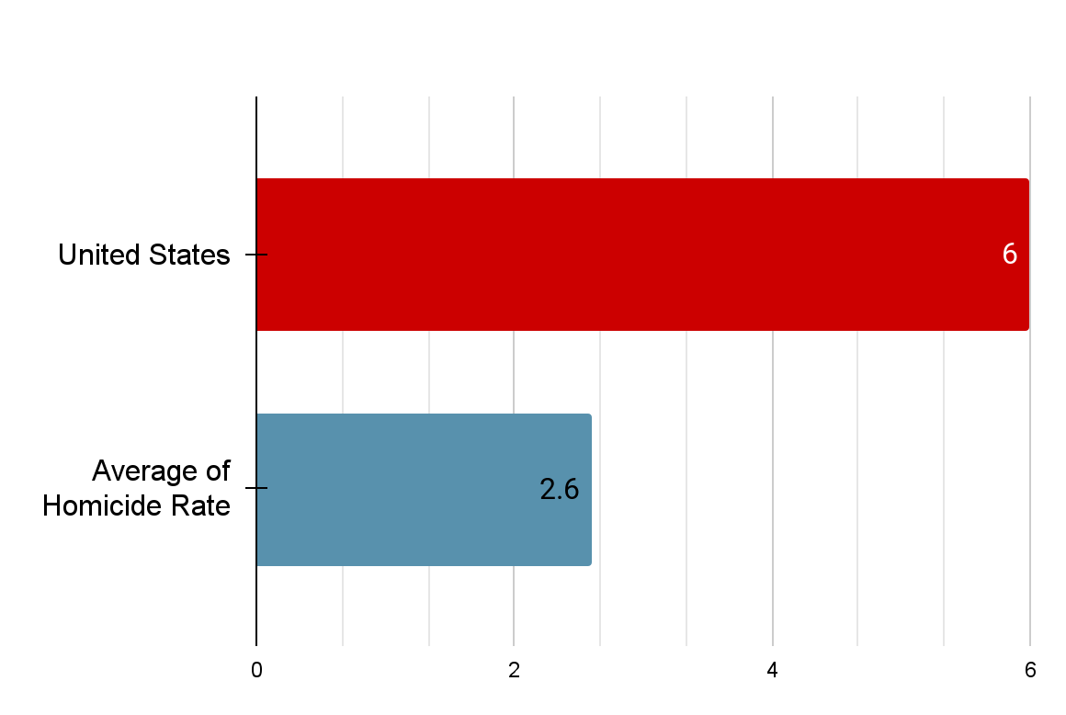
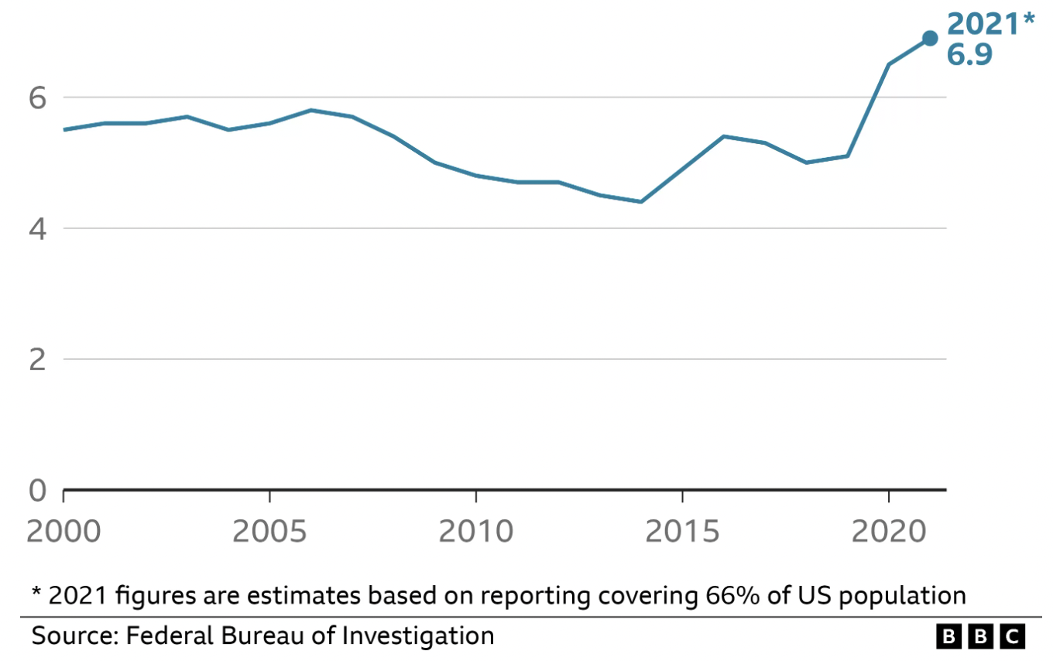
Project Introduction
Homicide Rate of OECD (per 100,000 Inhabitants)
The number of US murders (per 100,000 people)
The Homicide Rate of U.S. ranks 6 among 38 OECD countries
The number of Murders is increasing in the US

Slide 7


Project Introduction
Application that recommends a safe route for pedestrians, by predicting the riskiness of the roads

Slide 8



Project Introduction
Rabbit
Only recommend the Shortest Route
Recommend 4 Route considering Safety
Making People Safer

Slide 9
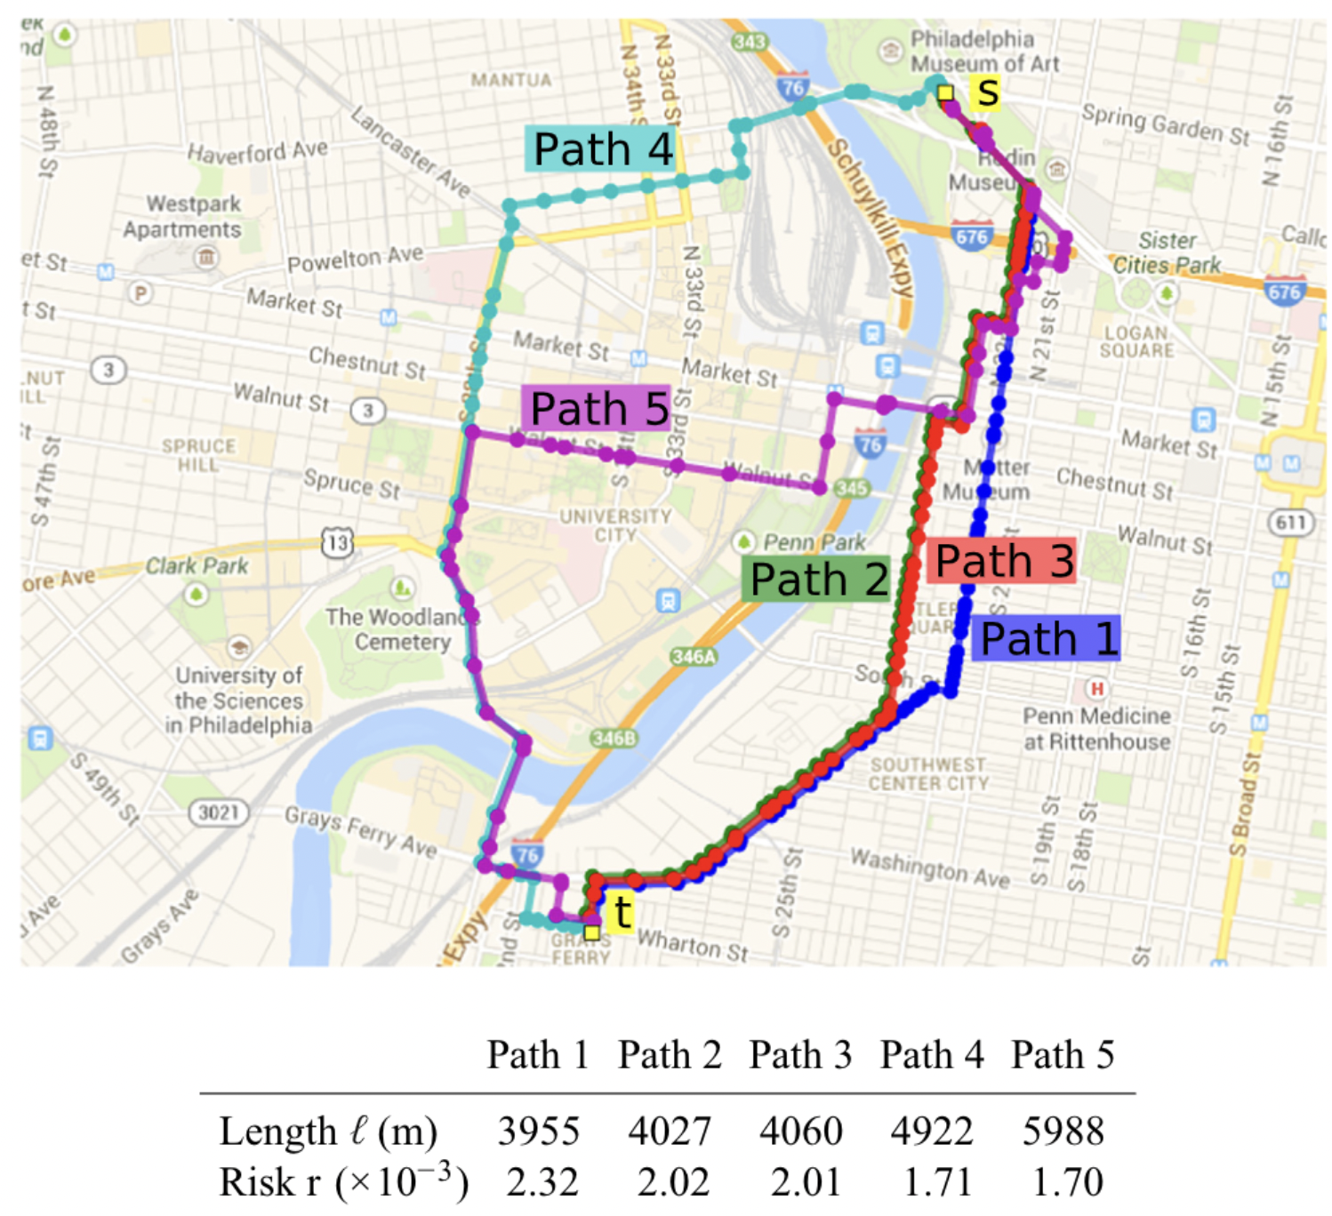
Project Introduction
Urban navigation beyond shortest routes : The case of safe paths.
- Galburn et al. (2016)
Limitation of paper
Use only crime data, not urban factors
Without considering its severity
Without predicting future riskiness
Reference.
E. Galbrun, K. Pelechrinis, and E. Terzi, “Urban navigation beyond shortest route: The case of safepaths,” Information Syst., vol. 57, pp. 160–171, Apr. 2016.

Slide 10
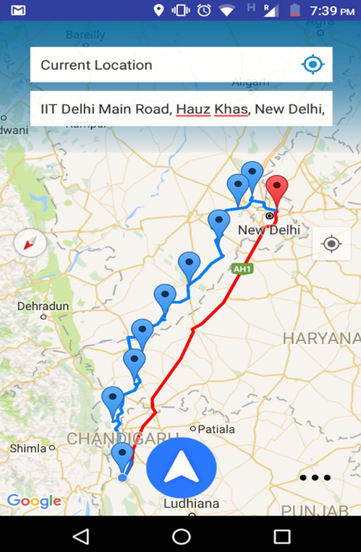
Project Introduction
A crowd-sourced adaptive safe navigation
for smart cities
- Goel et al. (2017)
Limitation of paper
Do not check the relation
between crime and urban factors
Do not predict the future risk
Provide only one route
Reference.
Neeraj Goel, Rajat Sharma, N Nikhil, S D Mahanoor and Mukesh Saini
, “A Crowd-Sourced Adaptive Safe Navigation for Smart Cities”, 2017 IEEE International Symposium on Multimedia (ISM), vol. 57, pp. 160–171, Dec. 2017.

Slide 11
Part 2
Data Explanation

Slide 12



Data Explanation
Collected Data
: Most of them were collected from the Chicago Portal
Crime
Facility
Service Request/Report
Urban Factors

Slide 13
Data Explanation
Collected Data (Crime)
31 Types of crime data
Homicide / Robbery / GunShot Sex offense / Assult / Theft ······.
Extract crime that can affect pedestrians
Occurred in 2018 and 2019
Location Information (longitude, latitude)

Slide 14





Data Explanation
Collected Data (Urban Factor - Facility) : 6 types
Fire Station
Library
Police Station
Public School
Support Service
Delegate Agency
CTA Bus Stop

Slide 15









Data Explanation
Collected Data (Urban Factor- Service Request/Report) : 10 types
Abandoned Building
Graffiti Removal
Street Light All Out
Rodent Baiting
Garbage Cart
Shot Spotter Alert
Sanitation code Complaint
Tree Trim
Tree Debris Removal
Abandoned
Vehicles

Slide 16
Part 3
Data Analysis

Slide 17

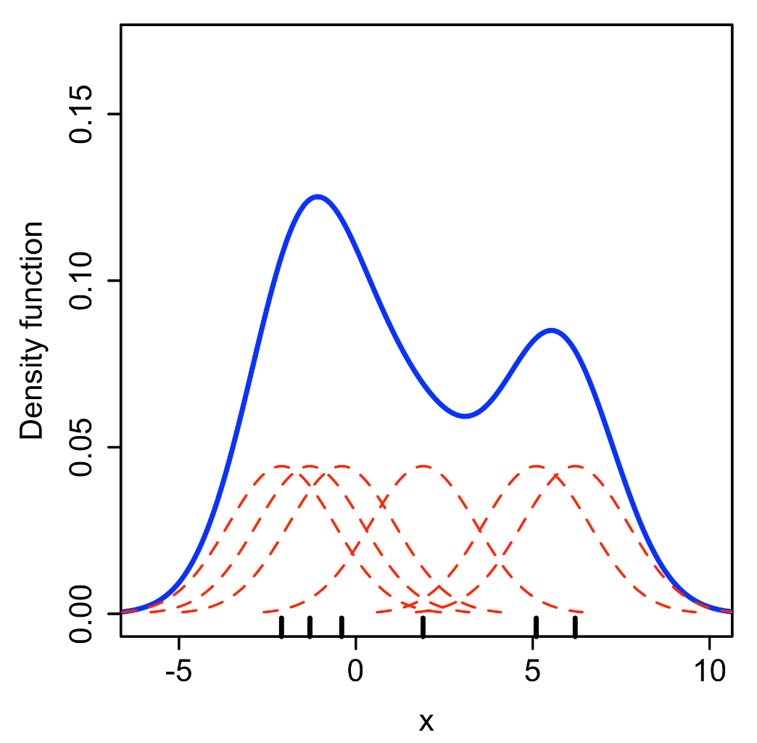



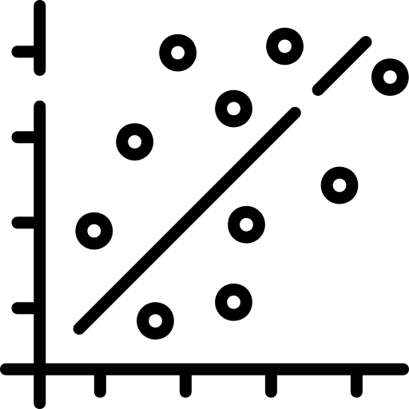

Data Analysis
Data Preprocessing
KDE Application
Correlation
Crime Data Extraction
Weighted Crime
Density estimation using KDE
Population Density Consideration
Correlation Calculation
Facility & service request data
Density estimation using KDE
By Drleft at English Wikipedia, CC BY-SA 3.0, https://commons.wikimedia.org/w/index.php?curid=57332968

Slide 18
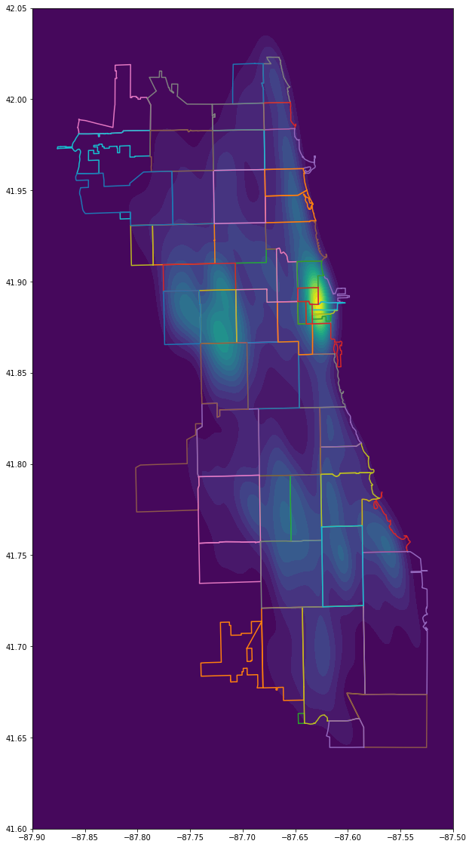
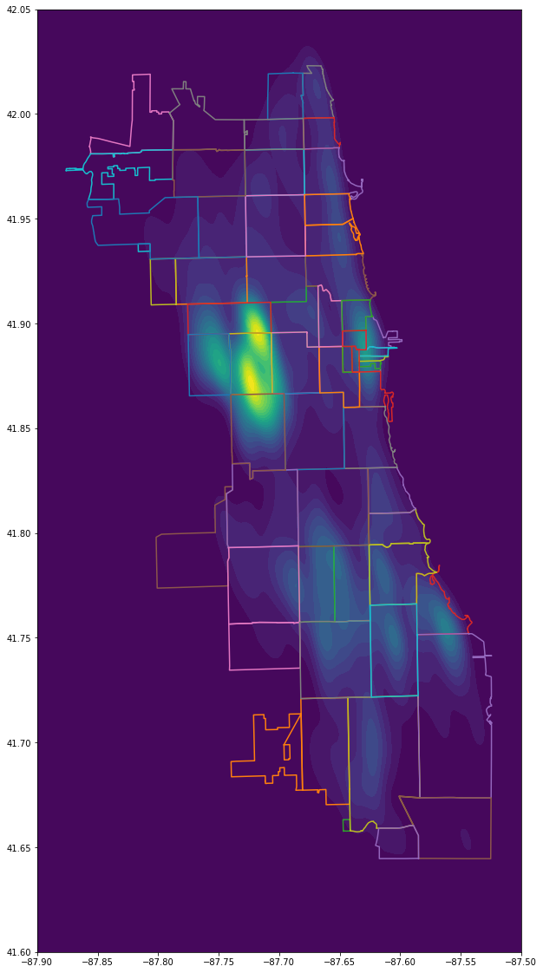
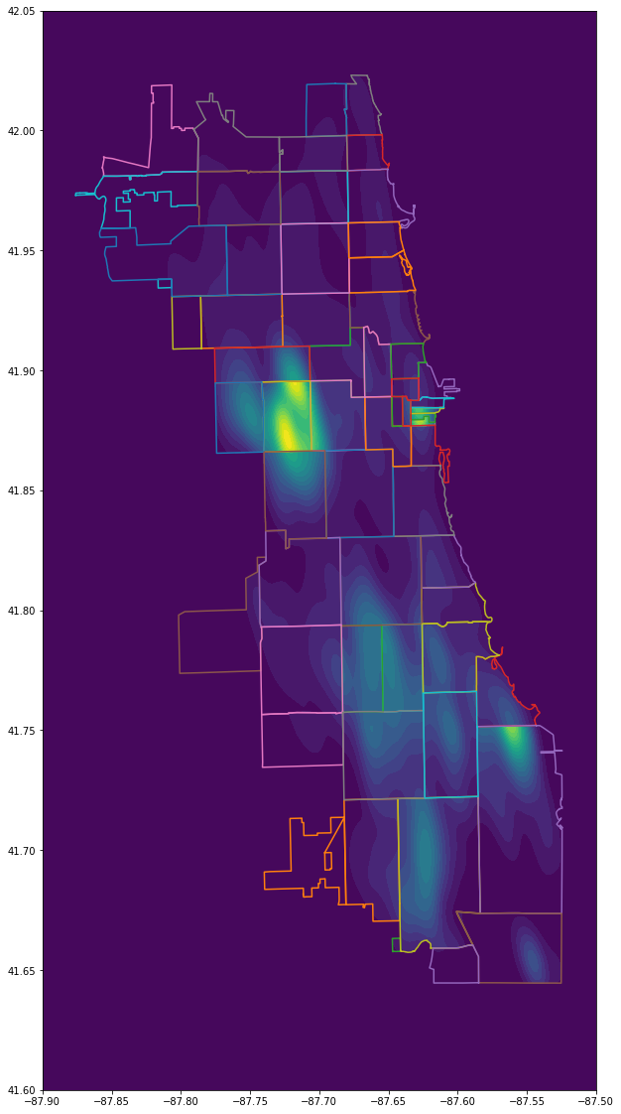
Data Analysis
Comparison with preprocessed crime data
Original data
Weighted Crime
Weighted Crime
with Population normalization

Slide 19
Data Analysis
Correlation of Crime Density and Urban Factors
Urban Factor \ Case | Correlation
Shot Spotter Alerts | 0.778
Abandoned Buildings | 0.662
Street Lights All Out | 0.594
Support Services Delegate Agencies | 0.522
Garbage Carts | 0.516
Public Schools | 0.493
Sanitation Code Complaints | 0.475
Tree Debris Removal | 0.407
CTA Bus Stops | 0.359
Libraries | 0.293
Fire Stations | 0.269
Police Stations | 0.268
Tree Trims | 0.244
Rodent Baiting | 0.173
Abandoned Vechicles | 0.101
Graffiti Removal | -0.109

Slide 20


Data Analysis
Model
2018
2019
Crime density
16 Types
Crime density
Urban factor density

Slide 21
Data Analysis
2018
2019
Model 1
Model 2
Crime density
Crime density
16 Types
train set : validation set = 7:3
10-fold cross validation
Urban factor density
2018
2019
Crime density
Crime density
16 Types

Slide 22
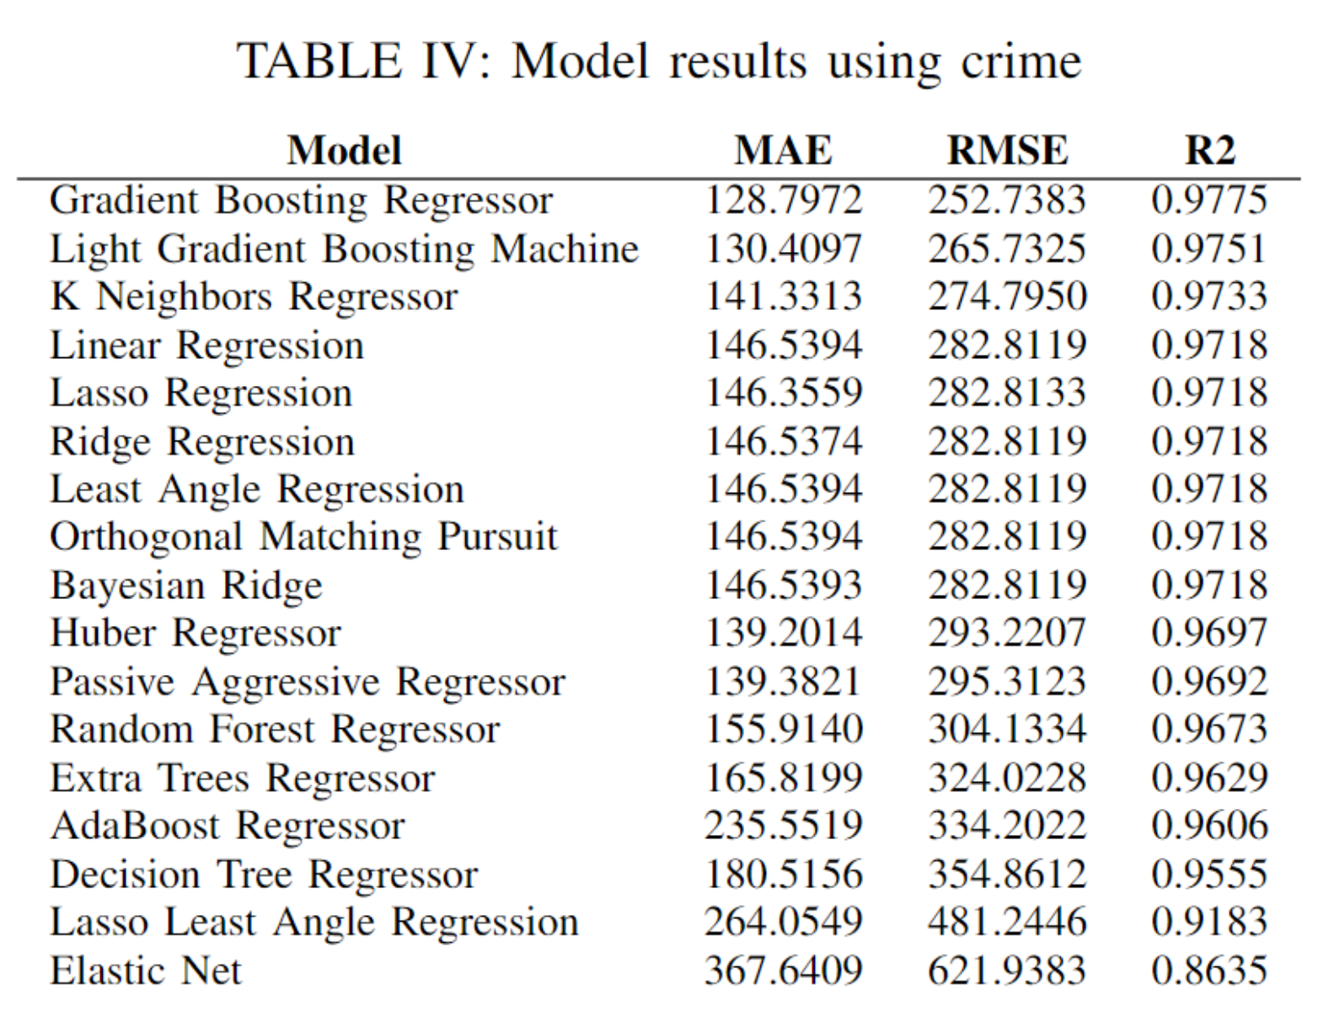
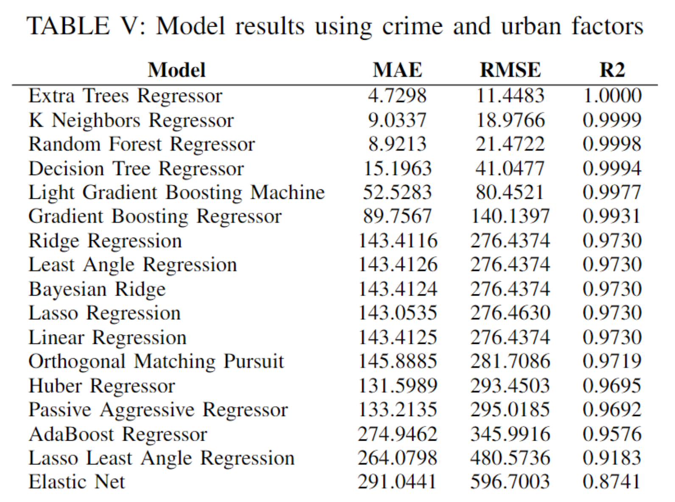
Data Analysis
Model Results: Average value of the validation set
Only Crime
Crime & Urban Factors

Slide 23
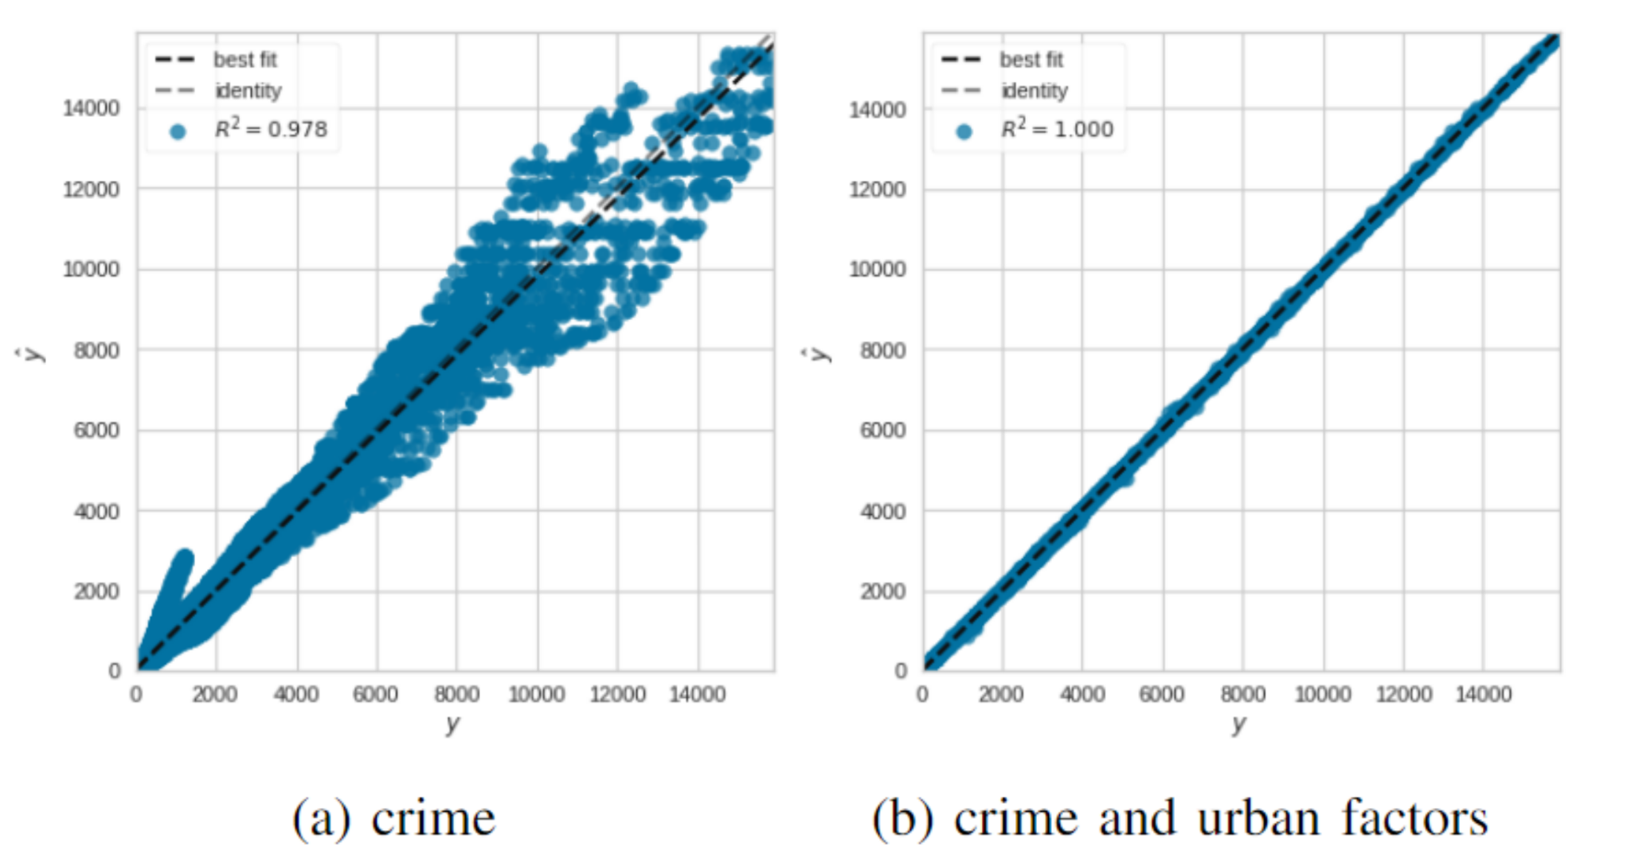
Data Analysis
Model Results: Prediction Error Plot

Slide 24
Data Analysis
Conclusion
Used Extra Trees Regressor model to predict the crime density
Regard the result as a Risk Score of the node
Verified the effectiveness of the Urban Factors
Suggest a method to calculate risk score

Slide 25
Part 4
Applying to Algorithm

Slide 26
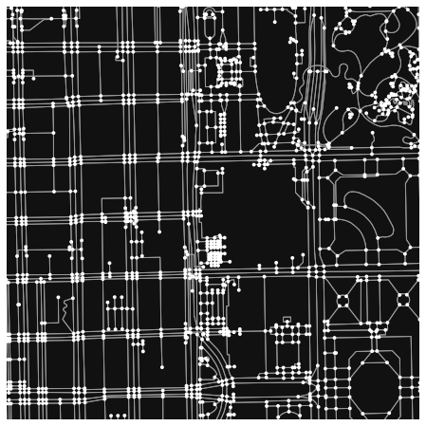
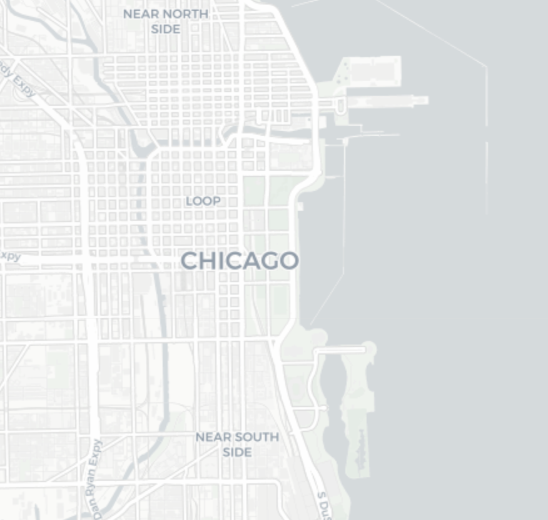
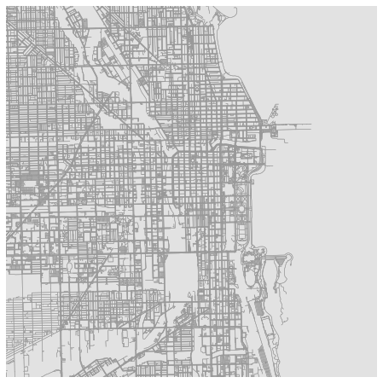

Applying to Algorithm
Road Networks - OSMnx
Node : intersection
Edge
: between intersections
Convert road network to the graph-based format

Slide 27
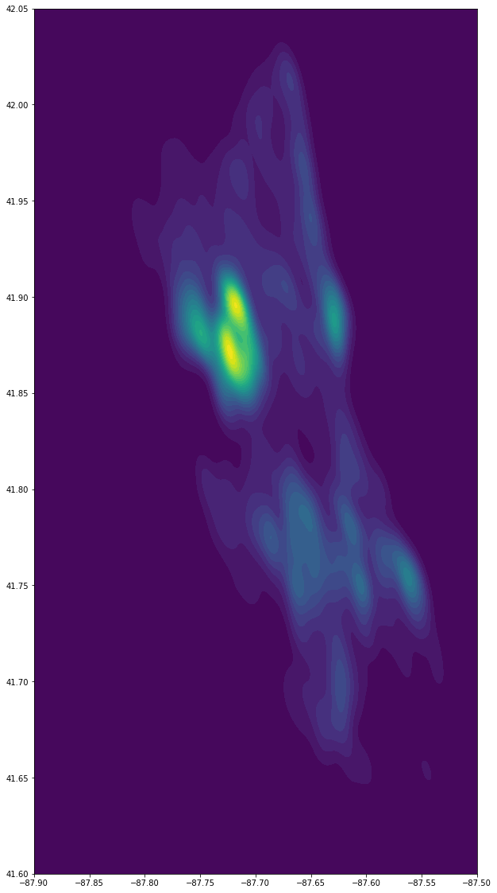
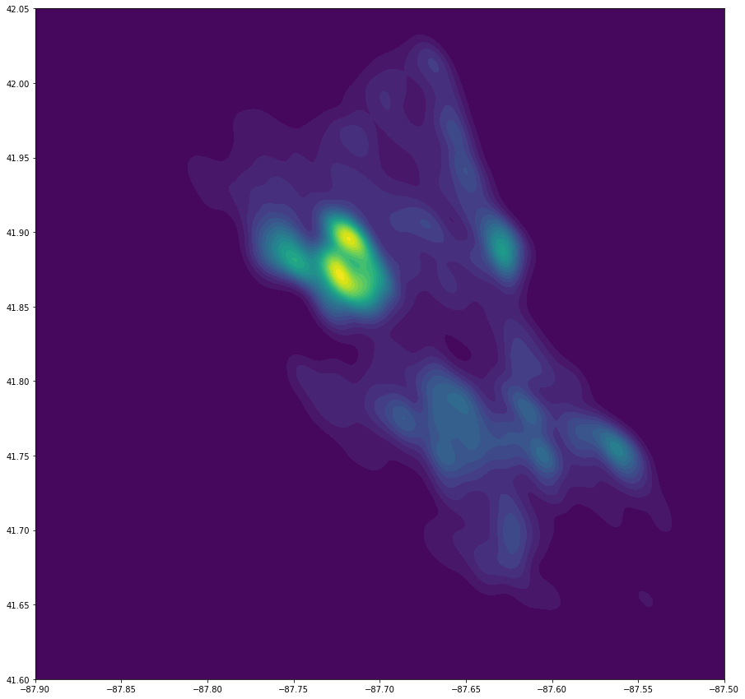
Applying to Algorithm
Imputing Risk Scores
Risk score of Node = Risk score of the Nearest Point
300
500
700
Divided into 1000 by 1000 cells
Risk score of Edge
= (Starting Node Score + End Node Score) / 2

Slide 28
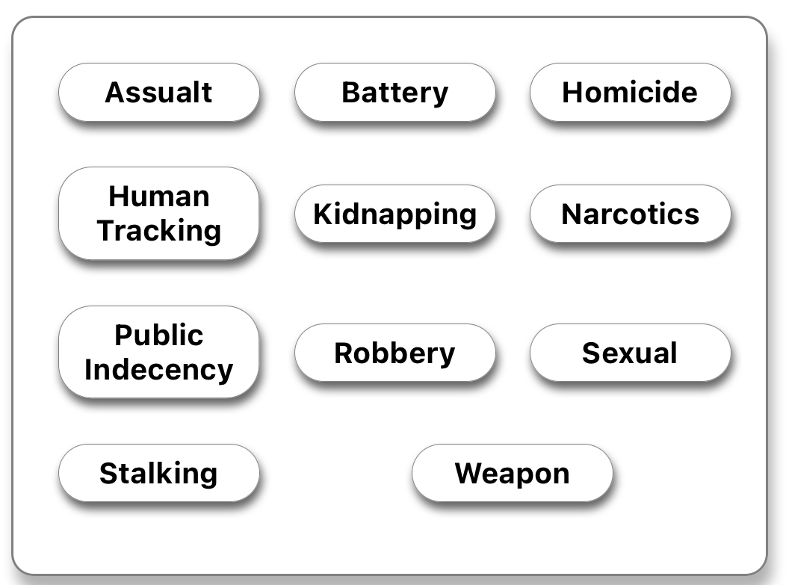

Applying to Algorithm
Imputing Risk Scores: Personal Risk Perception
Kidnapping
11 types of Crime Categories
Reflect personal risk perception
Select upto 6 crimes

Slide 29
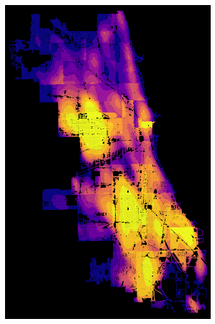
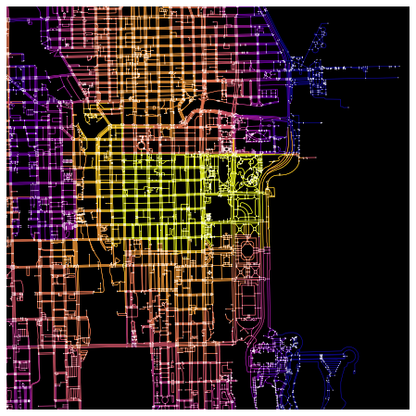
Applying to Algorithm
Road Networks - OSMnx
Result of Data Analysis
Result of using OSMnx
: Risk Score allocated to Node & Edge

Slide 30
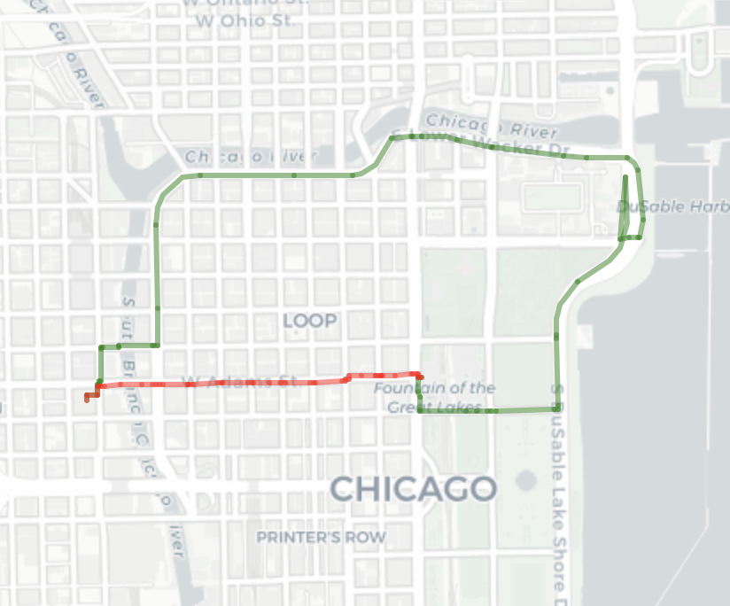
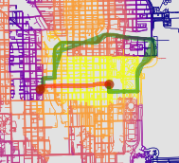
Applying to Algorithm
Applying Risk Score of the edge to the Shortest Path Algorithm
Add
Properly Combined
Paths
 | Total Length | Risk Score
Safest Path | 5,510 m | 151,345
Shortest Path | 1,427 m | 307,677

Slide 31
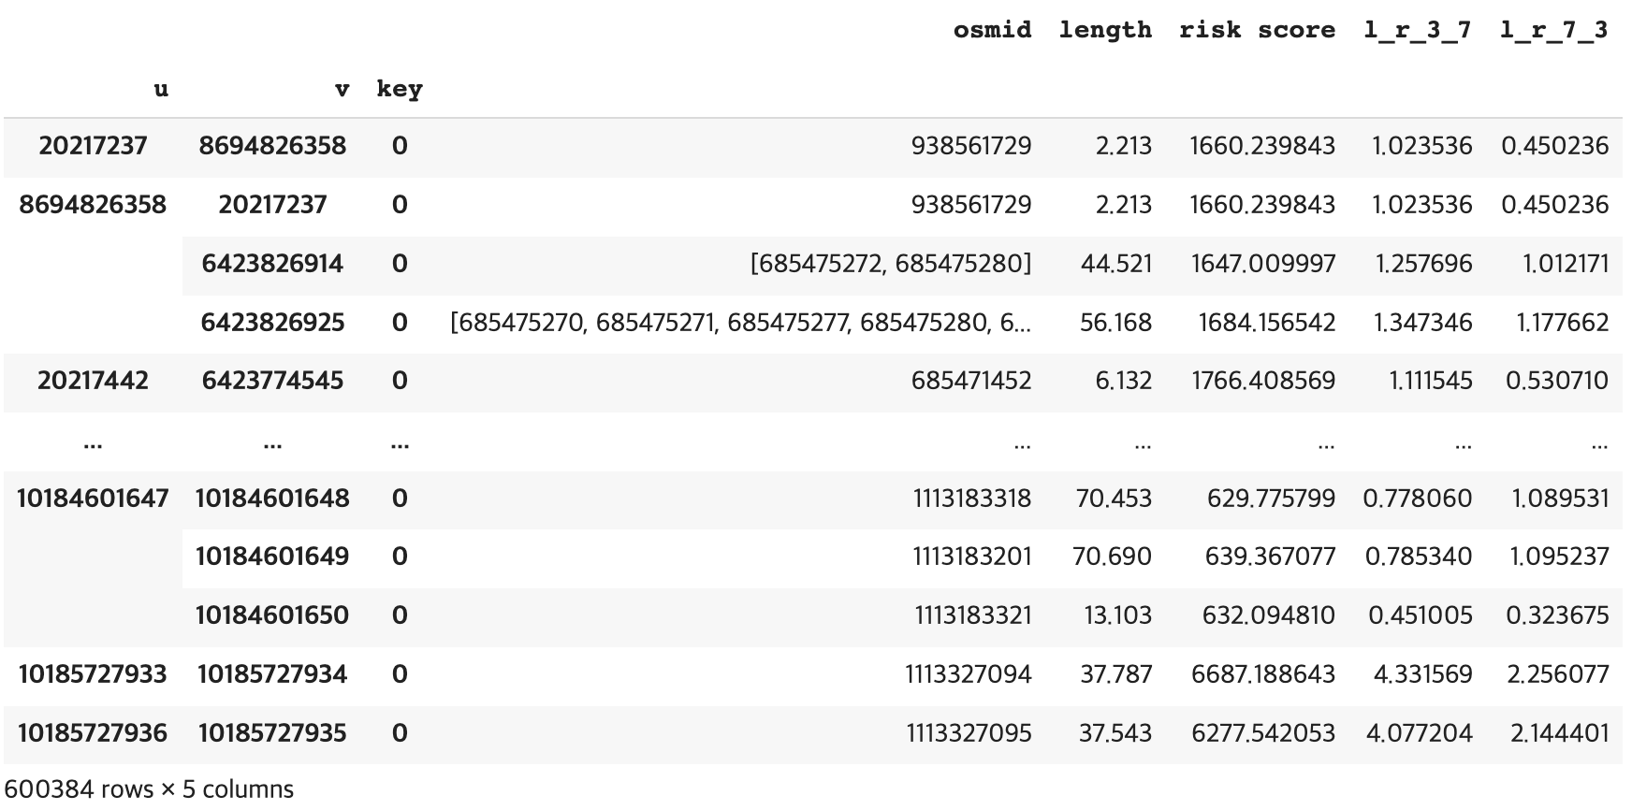
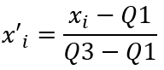
Applying to Algorithm
Results of the Algorithm
New Weight
Scaled using Robust Scaler
Ratio of 3:7 and 7:3
Length * α + Risk * (1-α)
α = ratio of length
Properly Reflect the Safeness and Shortness

Slide 32
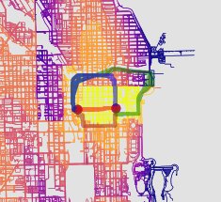
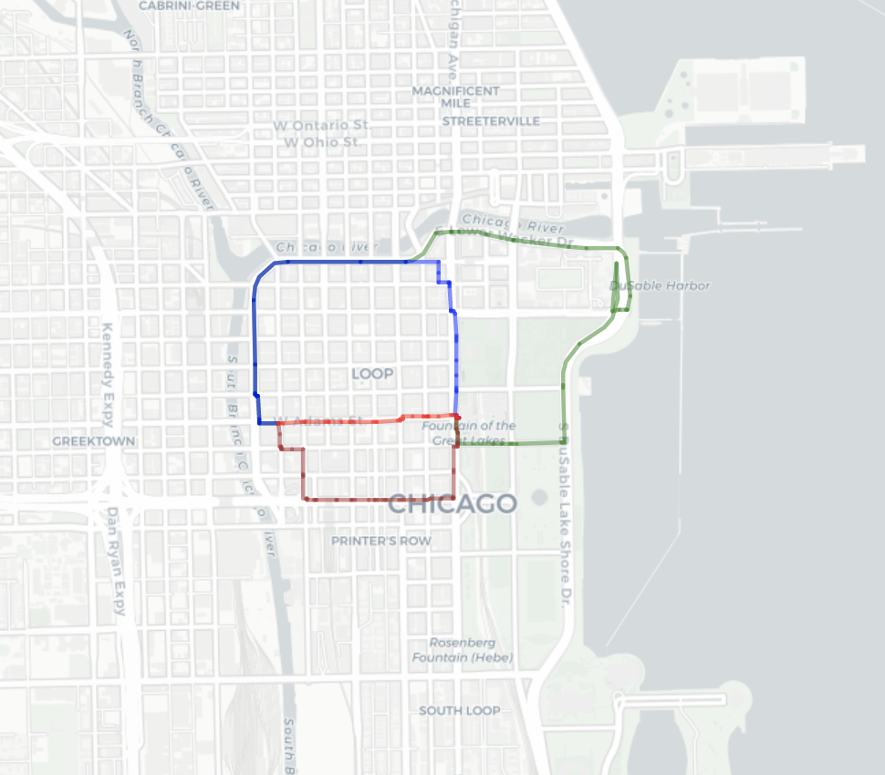
Applying to Algorithm
Results of the Algorithm : 4 Routes
Length : Risk | Total Length | Risk Score
0:10 (Safest) | 5,510 m | 151,345
3:7 | 2,973 m | 159,342
7:3 | 2,106 m | 187,787
10:0 (Shortest) | 1,427 m | 307,677

Slide 33
Applying to Algorithm
Evaluation of the weights
Randomly select 4,095 test cases in 16.5 billion cases
Each test cases returns 4 routes ⇒ Set Length : Risk Score as 0:10, 3:7, 7:3, 10:0
Length : Risk Score | Mean Length (m) | Mean Risk Score
0:10 (Safest) | 25,603 m | 156,942
3:7 | 17,787 m | 178,488
7:3 | 15,563 m | 227,430
10:0 (Shortest) | 14,803 m | 454,429

Slide 34
Part 5
Application

Slide 35

Application
Overall Process
[ Back-end ]
[ Data Analysis ]
[ Front-end ]
Save Personal
Risk Score
Calculate Risk score
Sign Up
API
User Request
User Info
Data Base
Orig / Dest
Risk Polygon
4 Routes
Route API
Get Personal
Risk Score
Return
4 routes
[ Algorithm ]

Slide 36











Application
Stack
Front-end
Back-end
Data Analysis & Algorithm

Slide 37
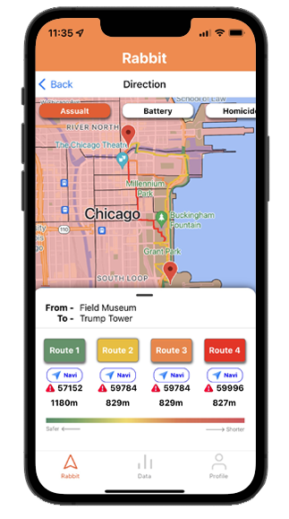
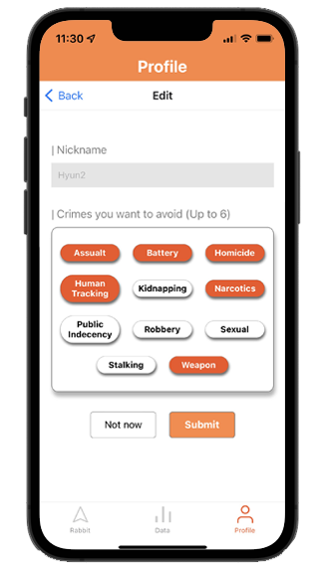
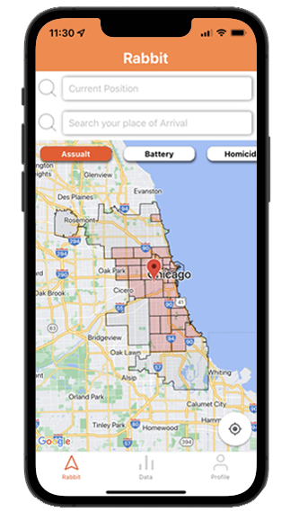
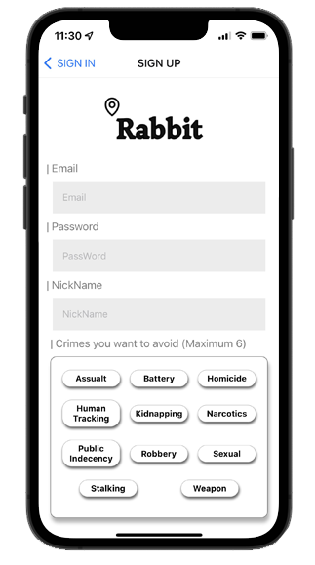
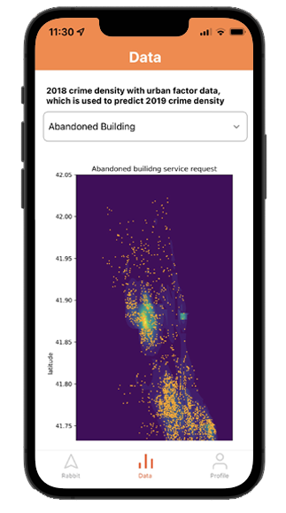
Application
Rabbit Application

Slide 38

Application
Sign up / Sign in

Slide 39
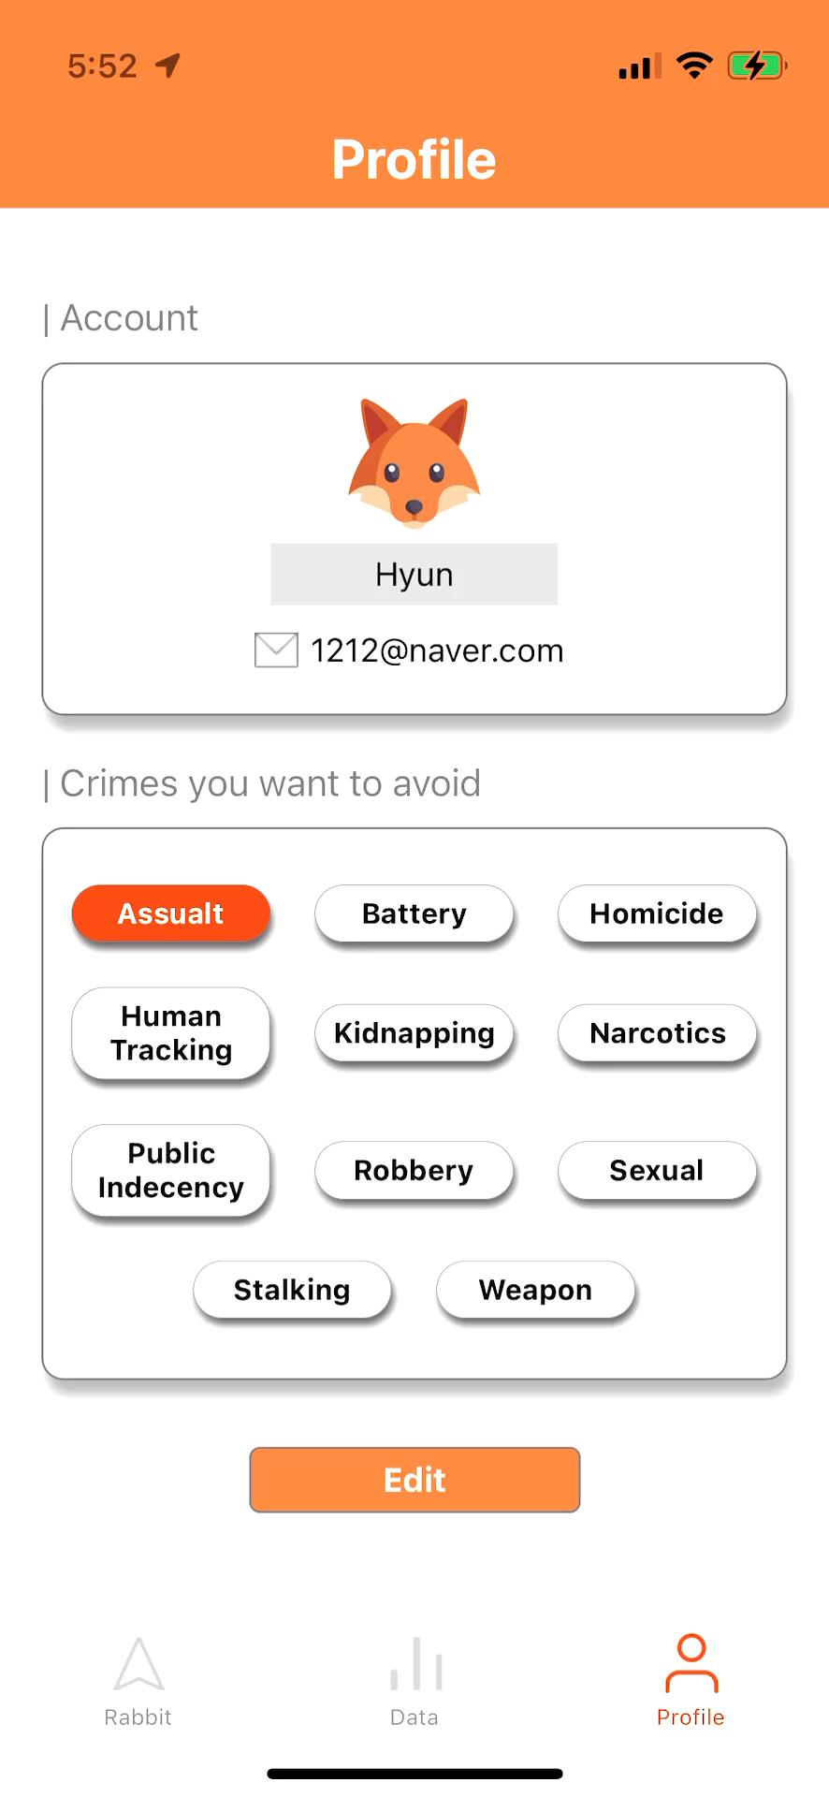
Application
Profile edit

Slide 40
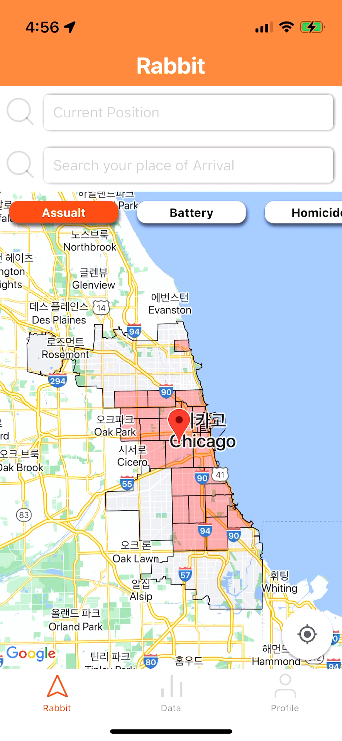
Application
Polygon function

Slide 41
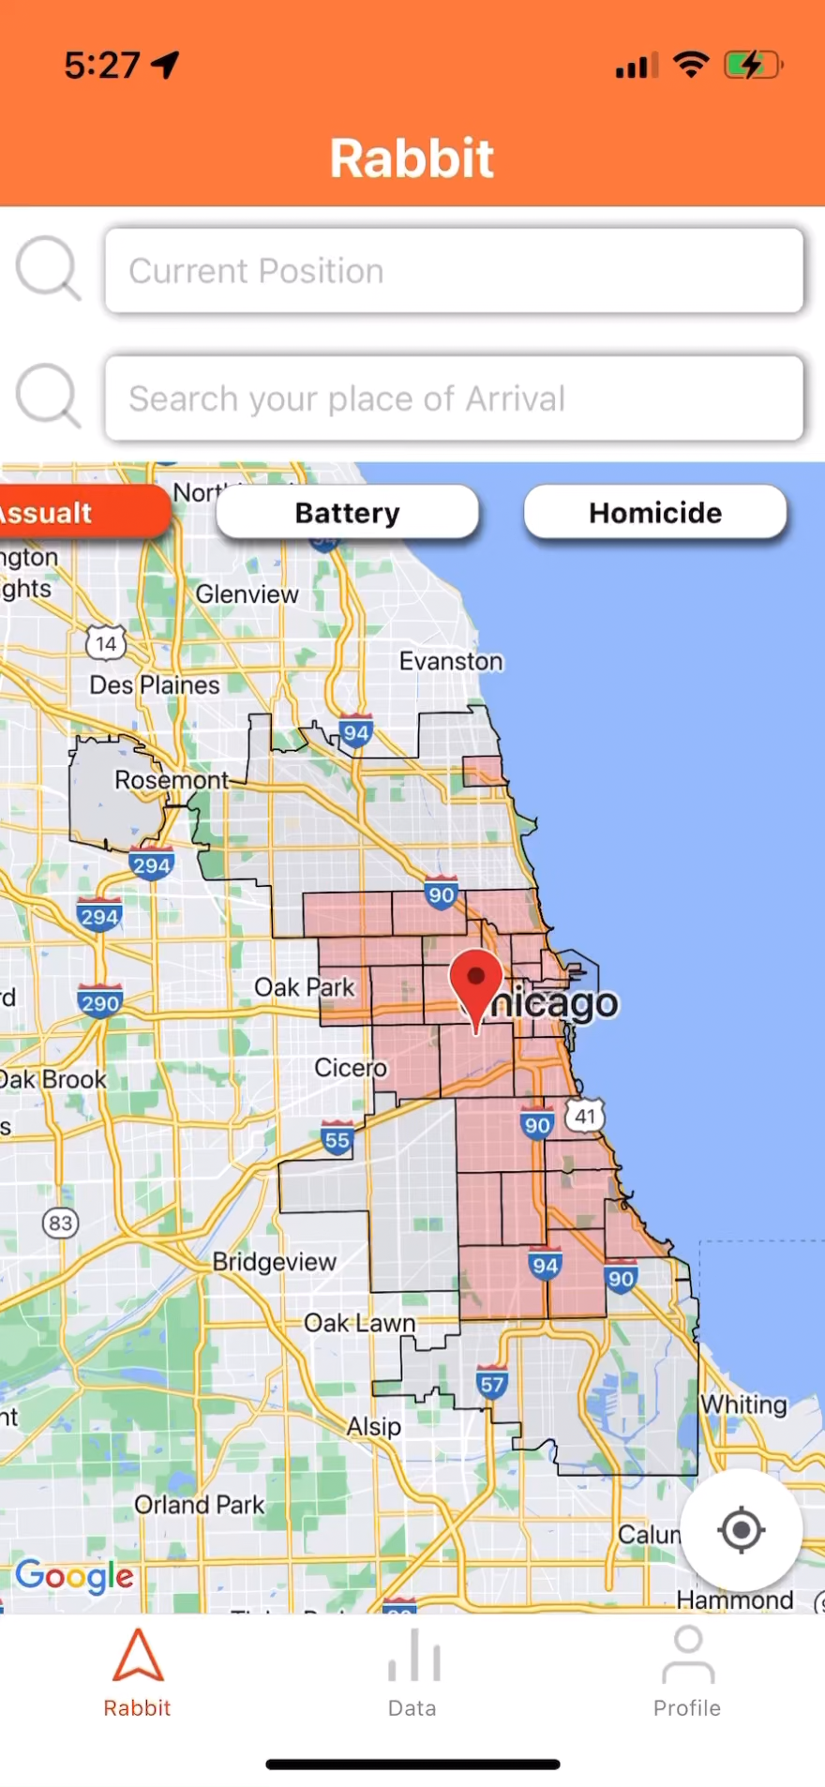
Application
Direction Recommendation

Slide 42
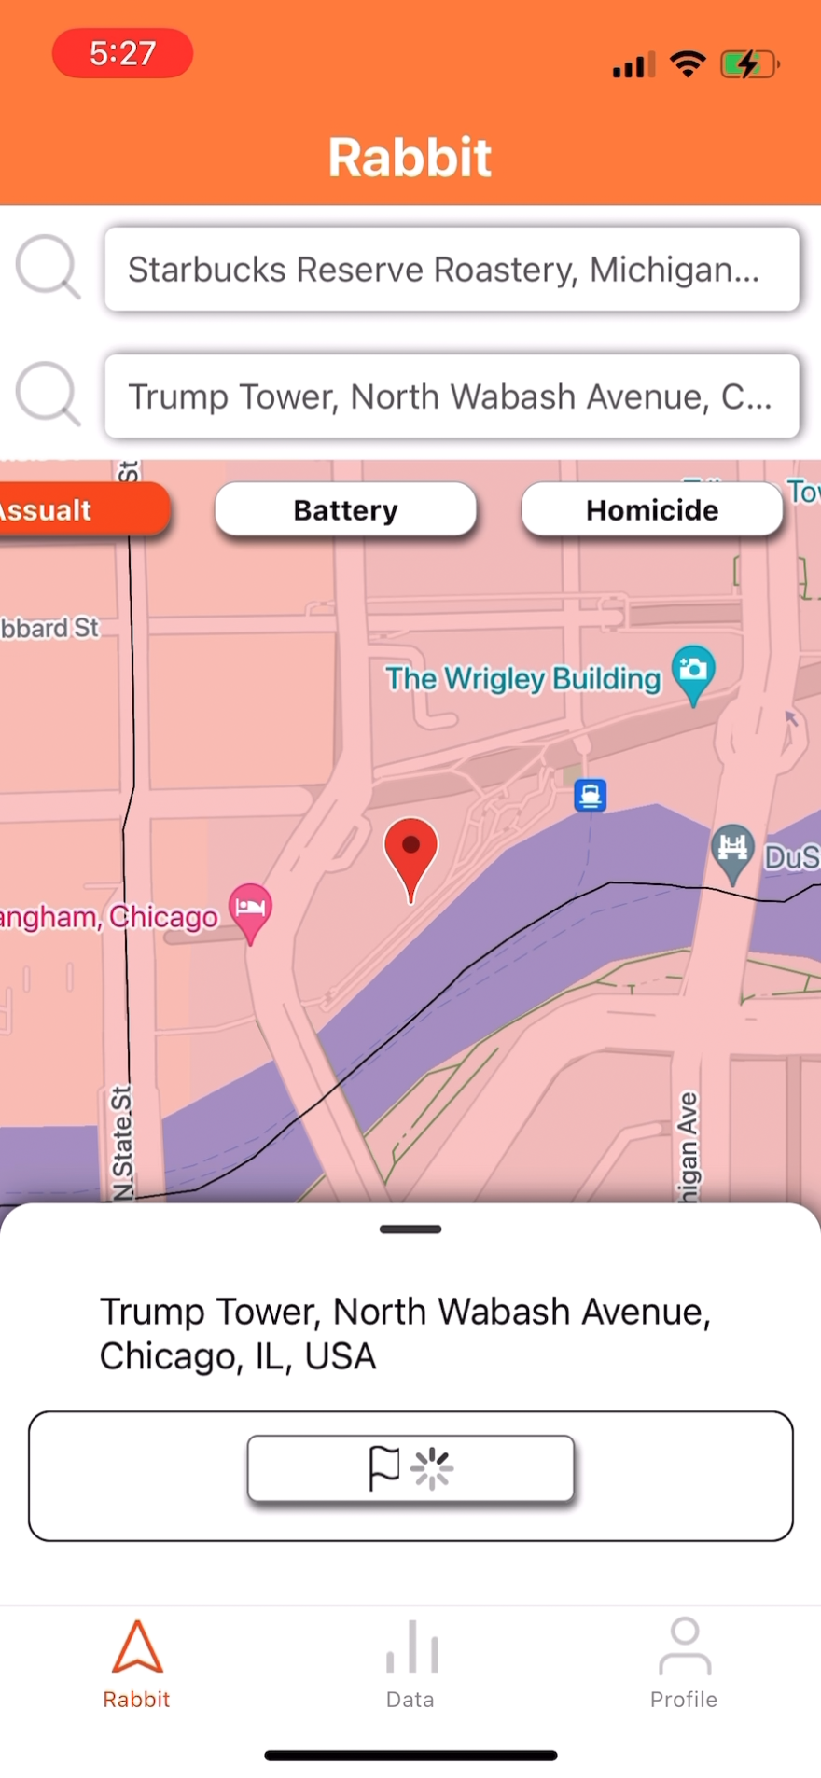
Application
Direction Recommendation

Slide 43
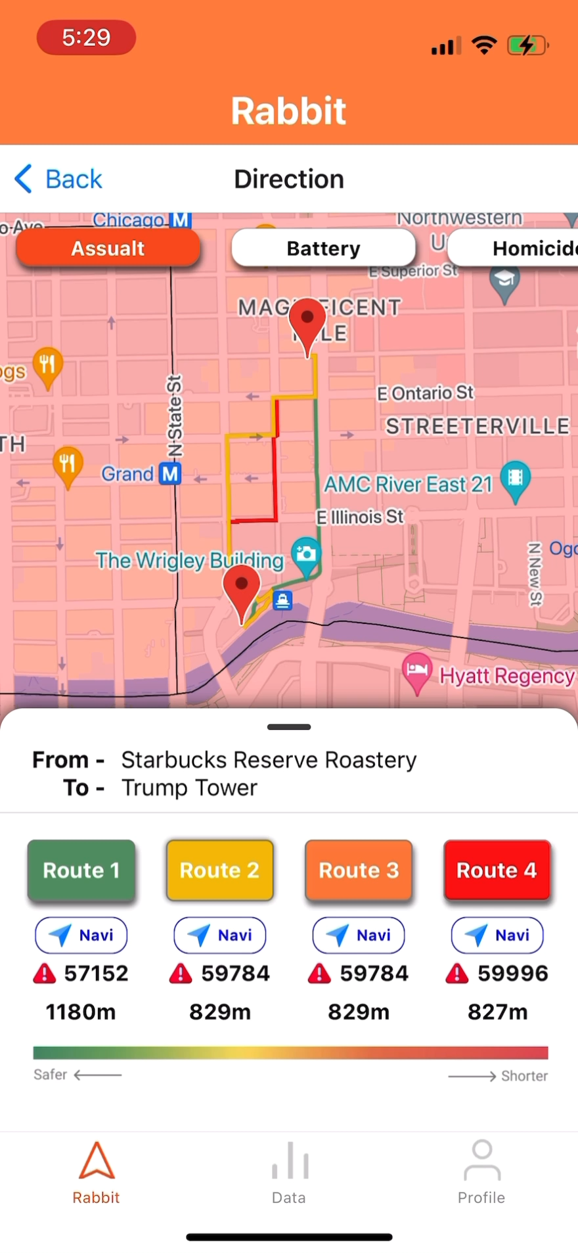
Application
Direction Recommendation

Slide 44
Part 6
Conclusion

Slide 45
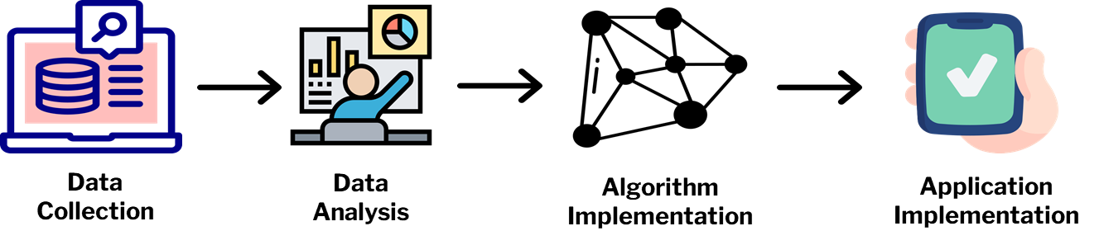
Conclusion
Summary of process in 4 months

Slide 46

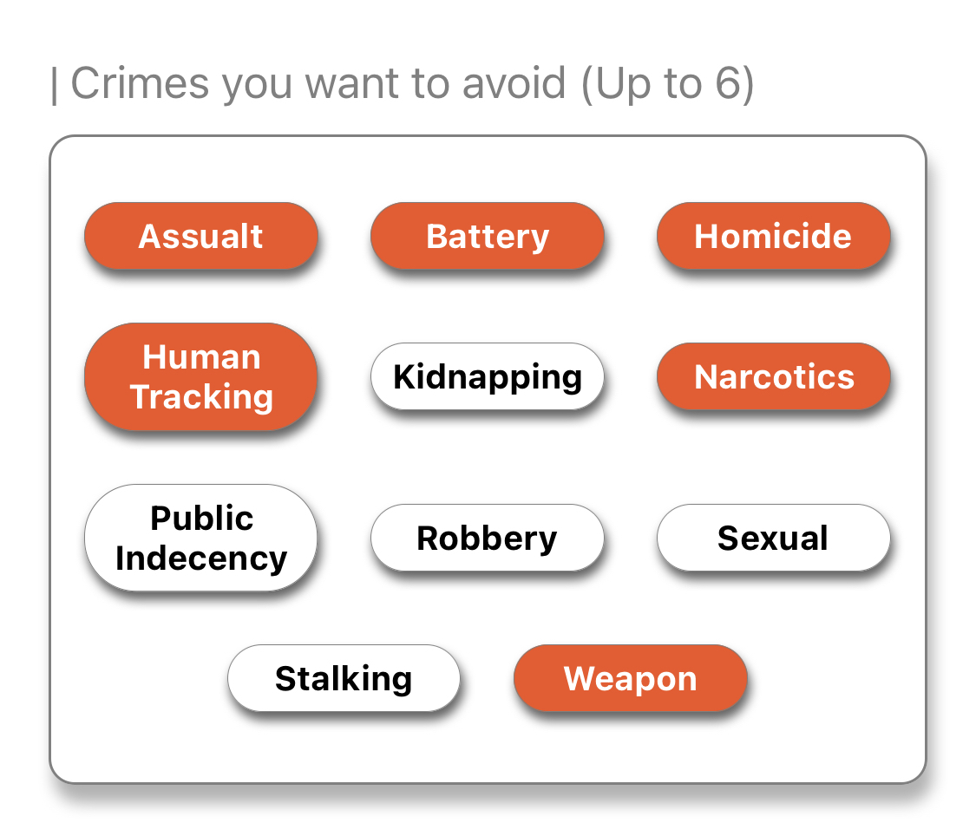
Conclusion
Novelty
Collected lots of Datasets
Verified & Analyzed
Model’s Ability of
Predicting Crime Density
Selecting Personal
Crime Types

Slide 47
Conclusion
Future Research
- Predicting generally: use recent data, not only from 2018 & 2019
- Extend the user scope to include drivers

Slide 48



Conclusion
Expected Effect
Team ChasingFox

Slide 49
Reference

Slide 50
Reference
[1] J. Horton. ”US crime: Is America seeing a surge in violence?”. BBC. https://www.bbc.com/news/57581270 (accessed Sep. 28)
[2] Galbrun, E., Pelechrinis, K., & Terzi, E. (2016). Urban navigation beyond shortest route: The case of safe paths. Information Systems, 57, 160-171.
[3] Goel, N., Sharma, R., Nikhil, N., Mahanoor, S. D., & Saini, M. (2017, December). A crowd-sourced adaptive safe navigation for smart cities. In 2017 IEEE International Symposium on Multimedia (ISM) (pp. 382-387). IEEE.
[4] Crimes - Map, Chicago Data Portal, Sep 15, 2011. [Online]. Available: https://data.cityofchicago.org/Public-Safety/Crimes-Map/dfnk-7re6
[5] CTA Bus Stops, Chicago Data Portal, Feb 28, 2017. [Online]. Available: https://data.cityofchicago.org/Transportation/CTA-Bus-Stops/hvnx-qtky
[6] Police Stations, Chicago Data Portal, June 10, 2016. [Online]. Available: https://data.cityofchicago.org/Public-Safety/Police-Stations/z8bn-74gv
[7] Fire Stations, Chicago Data Portal, Apr 18, 2019. [Online]. Available: https://data.cityofchicago.org/Public-Safety/Fire-Stations/28km-gtjn

Slide 51
Reference
[8] Libraries - Locations, Contact Information and Usual hours of Operation, Chicago Data Portal, Oct 28, 2021. [Online]. Available: https://data.cityofchicago.org/Education/Libraries-Locations-Contact-Information-and-Usual-/x8fc-8rcq
[9] Chicago Public Schools - School Locations SY2021 - Map, Chicago Data Portal, Jan 10, 2022. [Online]. Available: https://data.cityofchicago.org/Education/Chicago-Public-Schools-School-Locations-SY2021-Map/9ybt-s3ms
[10] Family and Support Services Delegate Agencies, Chicago Data Portal, Oct, 7. 2015. [Online]. Available: https://data.cityofchicago.org/Health-Human-Services/Family-and-Support-Services-Delegate-Agencies/jmw7-ijg5
[11] 311 service requests - vacant and abandoned buildings reported - historical, Chicago Data Portal, Mar, 7. 2019. [Online]. Available: https://data.cityofchicago.org/Service-Requests/311-Service-Requests-Vacant-and-Abandoned-Building/7nii-7srd/data
[12] 311 Service Requests - Street Lights - All Out - No Duplicates, Chicago Data Portal, Apr, 17. 2019. [Online]. Available: https://data.cityofchicago.org/Service-Requests/311-Service-Requests-Street-Lights-All-Out No-Dupl/756k-itxx
[13] 311 Service Requests – Sanitation Code Complaints - Historical, Chicago Data Portal, Mar 7, 2019. [Online]. Available: https://data.cityofchicago.org/Service-Requests/311-Service-Requests-Sanitation-Code-Complaints-Hi/me59-5fac

Slide 52
Reference
[14] 311 Service Requests - Graffiti Removal - Historical, Chicago Data Portal, Mar 7, 2019. [Online].
Available: https://data.cityofchicago.org/Service-Requests/311-Service-Requests-Graffiti-Removal-Historical/hec5-y4x5
[15] Violence Reduction - Shotspotter Alerts, Chicago Data Portal, Sep 15, 2022. [Online]. Available:
https://data.cityofchicago.org/Public-Safety/Violence-Reduction-Shotspotter-Alerts/3h7q-7mdb
[16] Illinois General Assembly - Legislation. (n.d.). Retrieved October 16, 2022, from
https://www.ilga.gov/legislation/ilcs/ilcs2.asp?ChapterID=5
[17] K. Spielberger, A. Marshall, C. Laval, A. Leonatti, B. Molitor, J. Fawbush, L. Temme, M. Buck, J. Calvopina, R. Dahl, S. Ellison, C. Hodder, T. Kelly, and J. Walker. “List of Criminal Charges.” FindLaw. https://www.findlaw.com/criminal/criminal-charges/view-all-criminal-charges.html# (accessed Nov. 18, 2022).
[18] U.S. Department of Justice. 112th Congress, 1st Session. (2012). Crimes Against Persons, Property, and Society. [Online]. Available: FBI UCR Library: NIBRS File: 2011
[19] “Crimes A-Z.” LV Criminal Defense. https://www.lvcriminaldefense.com/crimes-a-z/ (accessed Nov. 18, 2022).
[20] “List of Common Illinois Criminal Charges (The Illinois Crime Index).” Criminal Nuggets. https://illinoiscaselaw.com/crimes/ (accessed Nov. 18, 2022).

Slide 53
Thank You
Daye Kim
Hyun Roh
Presenter
Q&A Session
Kyunghee Univ.
Kyunghee Univ.
rlaek4793@khu.ac.kr
yeshyun@khu.ac.kr
Jihu Yang
Juwon Baek
Presenter
Q&A Session
Handong Global Univ.
Handong Global Univ.
zihooy@handong.ac.kr
21700340@handong.ac.kr
Heewon Jeong
Presenter
Chungbuk National Univ.
jhjmo0719h@chungbuk.ac.kr

Slide 54
Q&A

